Slide 1
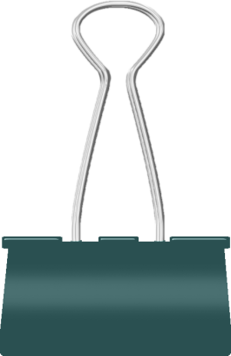
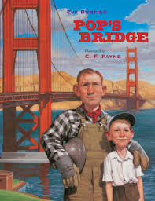
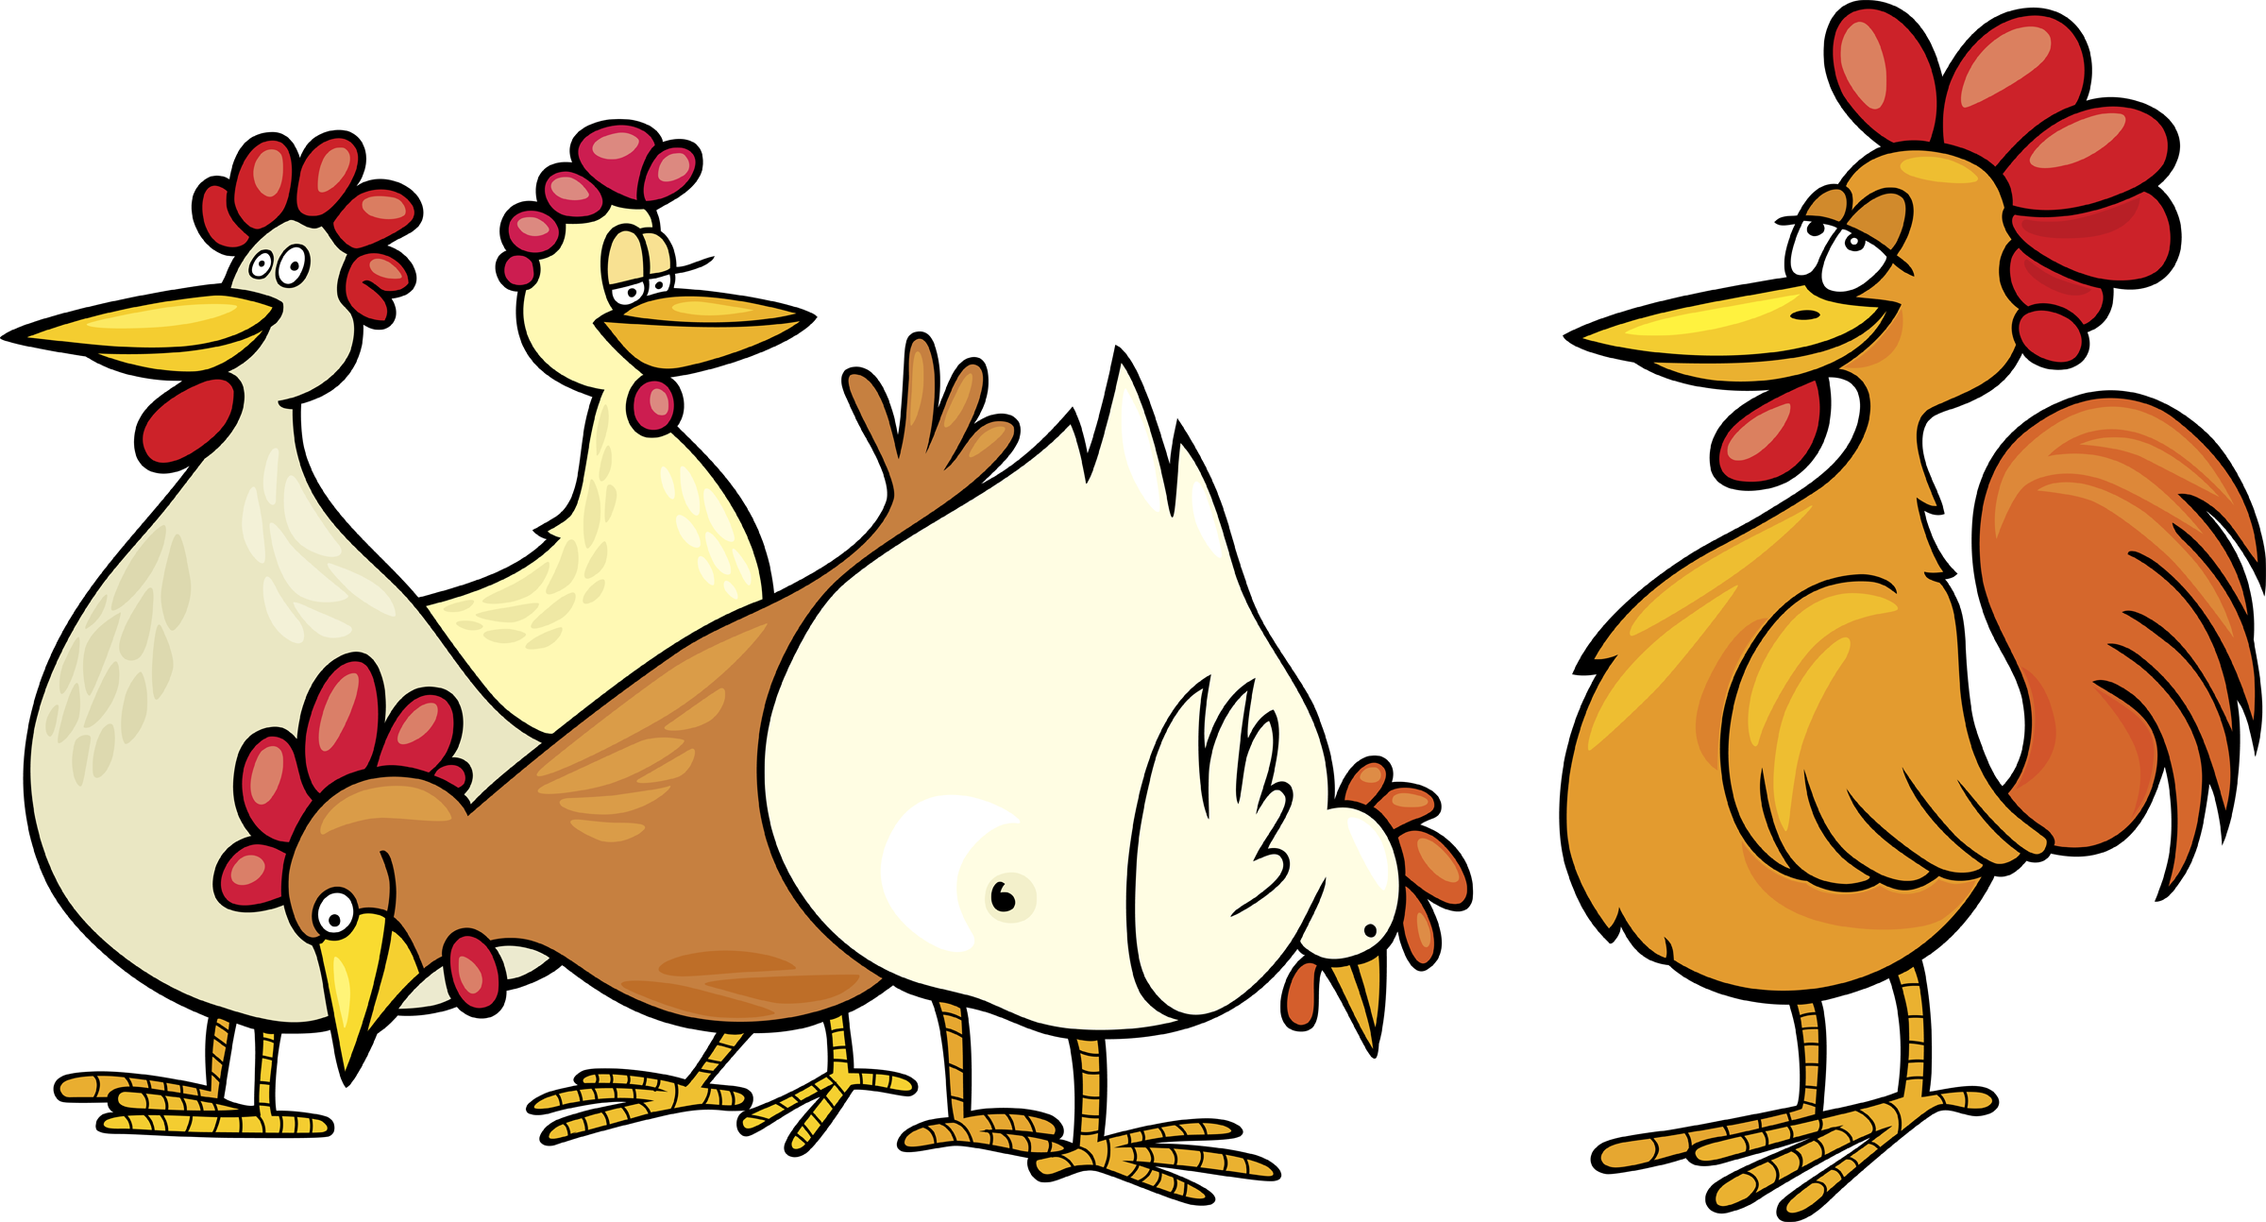
Editing Invitation
Grade 3
Apostrophes in Possessives
Day 1

Slide 2
Invitation to Notice
But I know my pop can do it. Whenever I say he’s building the bridge, Mom laughs. “There’s a crew of more than a thousand men working on that bridge, Robert. Including Charlie’s dad,” she reminds me. I know that, but I just shrug.
To me, it’s Pop’s bridge.
Notice OWNERSHIP
Day 1
Excerpt from Pop’s Bridge by Eve Bunting

Slide 3
Captain Cluck to the Rescue with… apostrophes
Click on me to see how I save the day when it’s time to eat!
Day 1

Slide 4
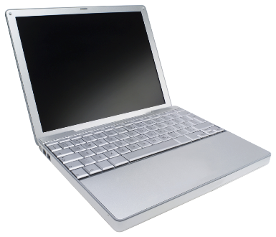
Singular Possessive Nouns
To make a singular noun possessive, just add ‘s
Singular Noun | Singular Possessive
student | student’s
pencil | pencil’s
The computer ’s screen needs cleaning.
Day 1
Use ‘s to show ownership!

Slide 5
Plural Possessive Nouns
For plural nouns that end in s,
just add an apostrophe to the end of the word.
The pencils’ erasers are worn down.
For plural nouns that do not end in s,
add an ’s to the end of the word.
The children’s bus was turning into the parking lot.
Day 1

Slide 6
Captain Cluck to the Rescue with… apostrophes
Robert
To remind us of apostrophes, we are going to watch Robert’s favorite video again.
Day 2

Slide 7
Who’s is it?
Turn these phrases into possessive nouns using apostrophes.
Work with a partner and write your answer on your white board.
1. a bone that belongs to the dog
the dog’s bone
2. the glasses that Dr. Wiler wears
Dr. Wiler’s glasses
3. the ringtone on my phone
my phone’s ringtone
4. a pencil that belongs to Destiny
Destiny’s pencil
5. homework that Tracy dropped
Tracy’s homework
Day 2
Reminder:
To make a singular noun possessive, just add ‘s

Slide 8
Who’s is it?
Turn these phrases into possessive nouns using apostrophes.
1. notebooks that belong to the students
the students’ notebooks
2. yarn that the cats play with
the cats’ yarn
3. flowers that the women grow
women’s flowers
4. toys that were given to the girls
girls’ toys
5. games that belong to the children
children’s games
For plural nouns that end in s, just add an apostrophe to the end of the word.
Day 2
For plural nouns that do not end in s, add an ’s to the end of the word.

Slide 9
The case of the missing apostrophes!
Help Captain Cluck determine where the missing apostrophe belongs in the sentence.
1. On opening day no cars are allowed on the town’s bridge.
1. On opening day no cars are allowed on the towns bridge.
2. I wear Pops handkerchief around my neck.
2. I wear Pop’s handkerchief around my neck.
3. The fishermen’s boats go under the bridge into the San Francisco Bay.
3. The fishermens boats go under the bridge into the San Francisco Bay.
4. Charlie’s smile stretches across his face as he watches.
4. Charlies smile stretches across his face as he watches.
Day 2

Slide 10
Captain Cluck to the Rescue with… apostrophes
Other chickens
How about we watch the other chickens’ favorite video.
Day 3

Slide 11
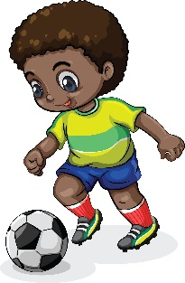
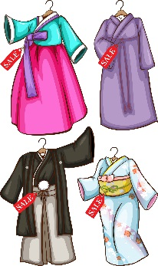
Nouns that end in -s
For nouns ending in –s, ask yourself if it is singular or plural.
If it is singular, add ’s to the end of the word.
a football that belongs to Chris
Chris’s football
Chris is one person
If it is plural, just add an ’ to the end of the word.
the dresses’ ribbons
the ribbons on the dresses
dresses is plural
Day 3

Slide 12
Who’s is it???
Decide if your noun is singular or plural
before you make it possessive.
1. the steering wheel on the bus
the bus’s steering wheel
2. basketball team for guys
the guys’ basketball team
3. pictures of the classes
classes’ pictures
4. the prize Charles won
Charles’s prize
5. homework the girls completed
the girls’ homework
Day 3

Slide 13
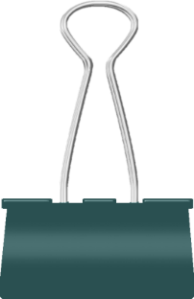
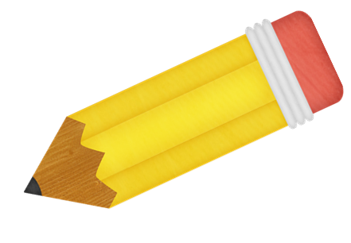
Invitation to Write
Find a place in your notebook to add possessive nouns.
OR
Write a new sentence about something that belongs to a friend, family member, or pet using a possessive noun.
Let me show you!
I was thrilled to be invited to Jenessa’s birthday party!
Day 3

Slide 14
Captain Cluck to the Rescue with… apostrophes
Other chickens
The chickens’ favorite video is here! Watch once more to make them happy!
Day 4

Slide 15
Test Talk: We try it together!
Nathan wrote a report on different types of bridges. Read his paper and look for any corrections he should make. Then answer the questions that follow.
(1) Bridges help people get from place to place. (2) They join communities and stretch across waterways. (3) They take us over roadways and landforms. (4) Floridas’ bridge connects the city of Miami to the island of Key Biscayne.
What change, if any, should be made in sentence 4?
Change Floridas’ to Florida’s
Change connects to connect’s
Change Miami to miami
Sentence 4 should not be changed.
Day 4

Slide 16
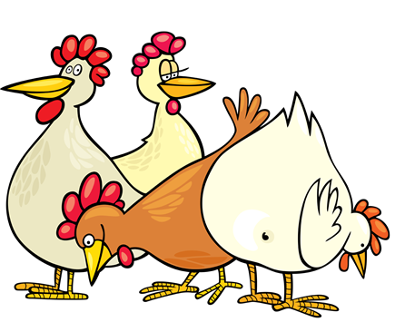
Test Talk: We try it together!
(9) The beam bridge is the simplest kind of bridge for a crew to build and it costs the least. (10) The beams are put across supports called piers. (11) It is important the piers distance be close enough together to give the beam strength. (12) That way, the roadway won’t bend or sag too much when traffic crosses it.
What change, if any, should be made in sentence 11?
Insert a comma after important
Change piers to piers’
Change enough to enouff
Change the period to a question mark.
Day 4

Slide 17
Test Talk: We try it together!
(5) People have been building bridges for thousands of years. (6) They think about how long the bridges roadway must be. (7) They think about what the bridge will cost. (8) Then they decide what kind of bridge to build.
What change, if any, should be made in sentence 6?
Change They to They’s
Change bridges to bridge’s
Change roadway to Roadway
Sentence 6 should not be changed.
Day 4

Slide 18
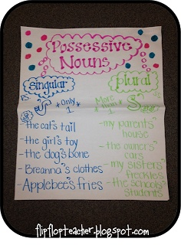
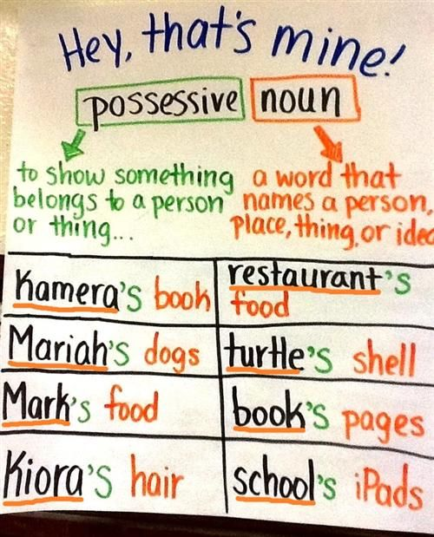
Anchor Chart Ideas

Slide 19
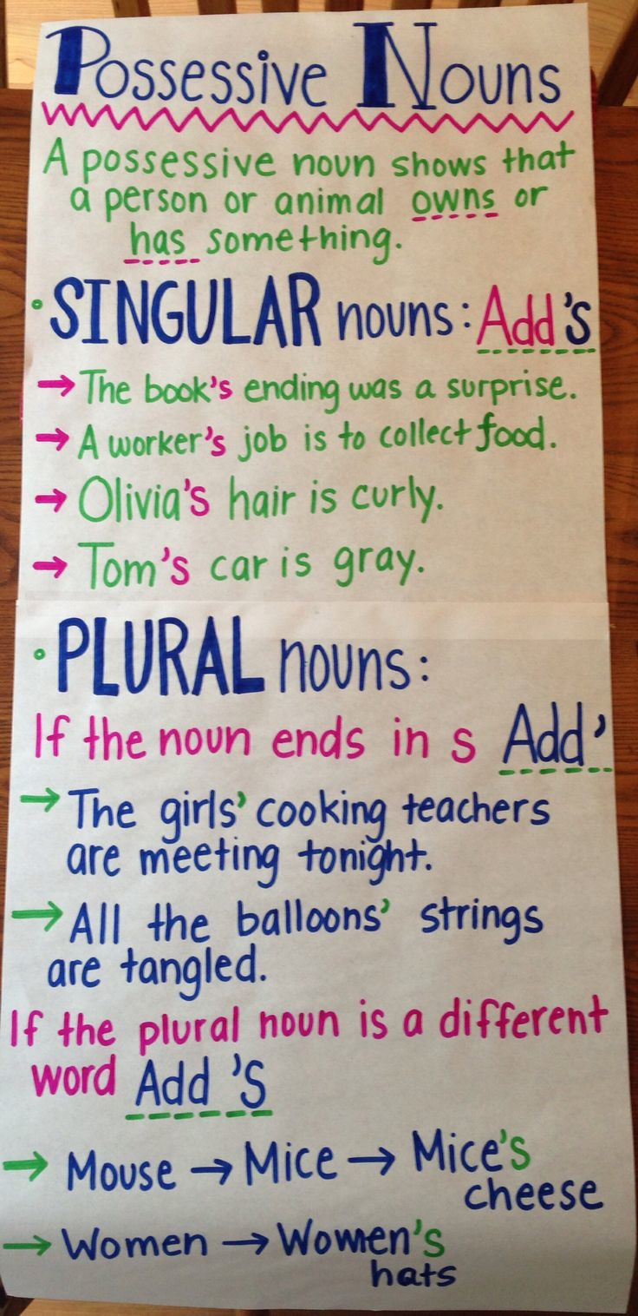
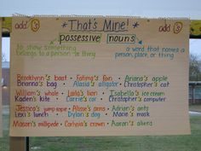
Anchor Chart Ideas

