Slide 1
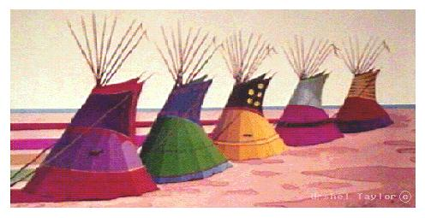
American Indians
Vocabulary
b (1)(A) and (2)(A) History

Slide 2
Word/Definition Your Sentence

Slide 3
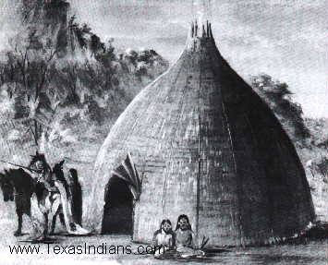
Sedentary
Staying in one place

Slide 4
Adobe
Building material made of
dried clay mud

Slide 5
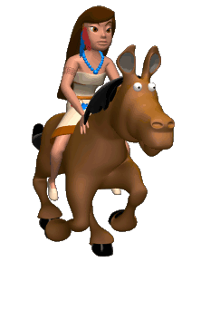
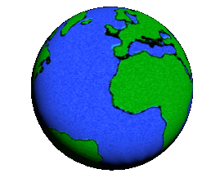
Nomadic
Groups of people who move from place to place

Slide 6
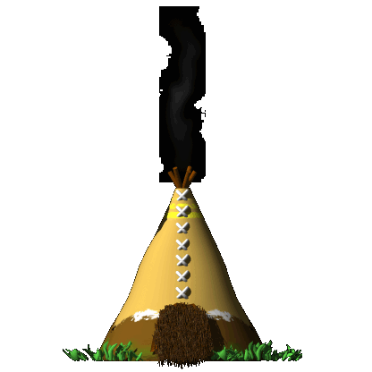
Tepee
Movable homes made from animal hides stretched over long poles

Slide 7
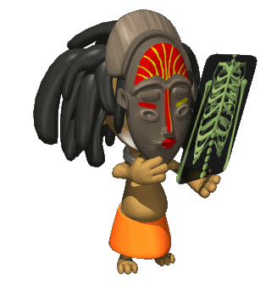
Shaman
  A religious figure who was believed to have healing powers

Slide 8
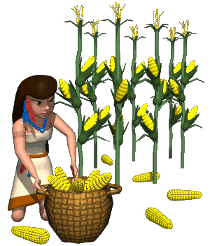
Maize
Native American name for corn

Slide 9
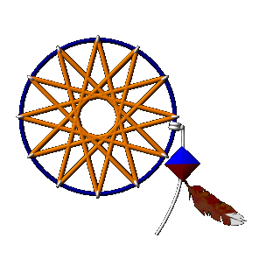
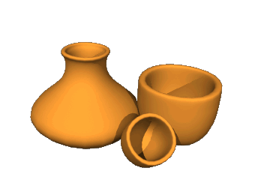
Artifact
Tools, weapons, and other objects made by people

Slide 10
Analogies
Complete the following analogies:
1. ____ is to bricks as buffalo hide is to teepee.
2. ____ is to doctor as lawyer is to attorney.
3. ____ is to sedentary as salt is to pepper.
Create your own analogy using the American Indians vocabulary.

